Slide 1
IT Support Essentials
MSP NAME HERE
Secure your mission-critical business assets and minimize risk with baseline IT security and support services
Presented by: Date:

Slide 2

About us
This is where you introduce your MSP. Here are a few bullet points to get you started.
Our experience
Our specializations
Our availability
Our response times
Our team
Our commitment to you

Slide 3
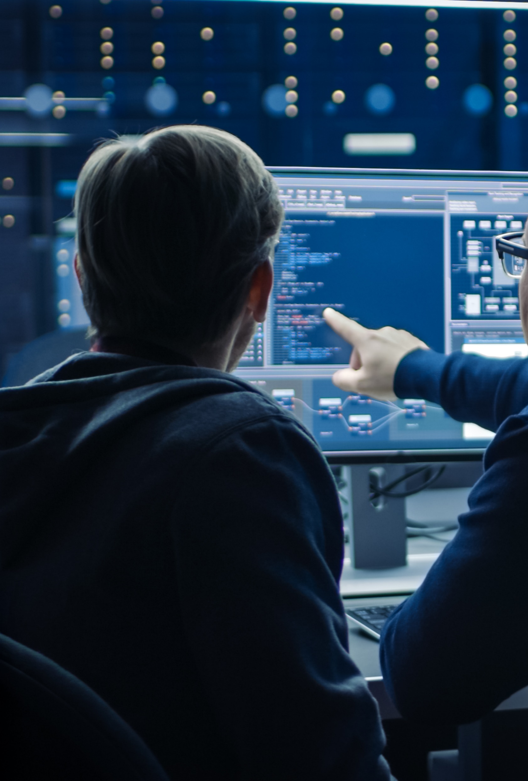
Your business is navigating constant change
Small companies like yours make up around 90% of all the businesses on earth and employ 50% of the people in the global job market.¹
However, you’re grappling with more challenges than ever.
No in-house tech support resources
Cloud application and infrastructure use
Remote work security and management
Cyber risks and threats
Increased competition driving the need for digital transformation
¹ “Small and Medium Enterprises (SMEs) Finance,” Webpage, World Bank, https://www.worldbank.org/en/topic/smefinance. (Accessed 2022-10-22)

Slide 4

Care for your business technology in just the right amount
Technology isn’t your day job. Let us carry the day-to-day burden of IT management and security for you.
You want to get the most out of your investment in technology. Let us show you how.
You need standardized cybersecurity and IT support to mitigate the risk to your data and workflow. That’s what we do.

Slide 5
Introducing IT Support Essentials
The right IT support mix – the right program size – the right people
IT Services:
Advanced Performance Monitoring
Network Device Monitoring and Management
VPN Monitoring + Management
Routine Server + Desktop Maintenance
Key Application Maintenance and Management
Device Optimization
Software License and Hardware Asset Management
Cybersecurity:
Quarterly Security Risk Assessment
Firewall Monitoring and Management
Endpoint Protection
Patch Management - Windows + Third Party
Mail Filtering and Protection
2FA + Password
Backup:
Backup - Desktop - Critical Documents
Backup - Server (if applicable)
Backup – Microsoft 365 (if applicable)

Slide 6
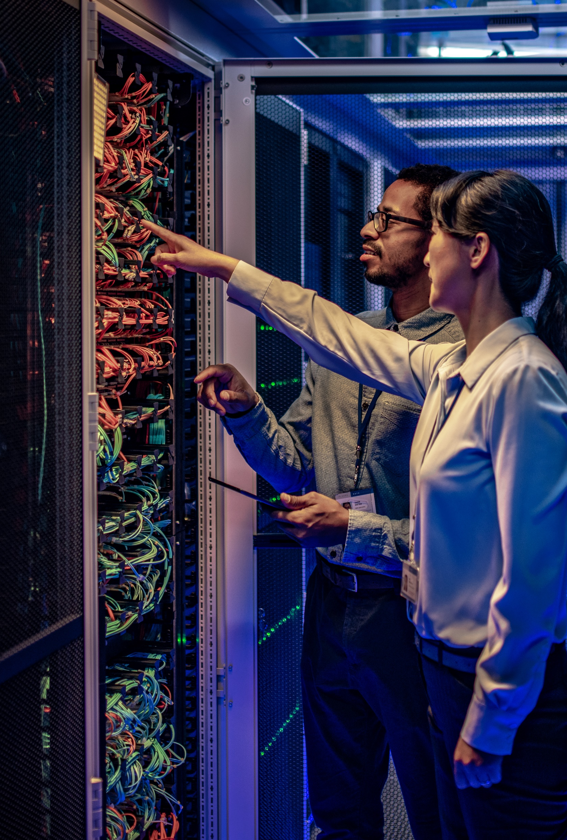
Baseline IT support for each aspect of your IT environment
Our team can provide ongoing care for all your IT assets.
Phones and tablets
Laptops and desktops
Networking
Servers
Storage
Peripherals
Printers

Slide 7

Some benefits of out IT support essentials program
Reduced downtime
IT systems are less likely to experience unplanned downtime when they're regularly monitored and maintained.
Improved security
Regular maintenance can help identify and fix security vulnerabilities before they're exploited.
Increased productivity
Well-maintained IT systems are more reliable and user-friendly, resulting in increased productivity for users.
Better decision making
With up-to-date information on your IT assets and performance, you can make more informed decisions about where to allocate resources.

Slide 8
IT support essentials – the right mix of IT service for your business
Use the best tech for your processes
We provide a standardized stack of protocols and technologies that have been proven throughout the industry.
Add services as you grow
Easily add more IT support when needed for new staff, new business opportunities, and business growth.
Get constant coverage
Get the mix of strategic advice, ongoing management/monitoring, and support you need to keep your systems operating at optimal levels.
Mitigate your risk
We will put the appropriate IT security in place for your current risk profile and upgrade those services as it becomes warranted by your growth and corresponding increased risk exposure.

Slide 9

Why other small business choose to partner with COMPANY for IT support essentials
two or three short, impactful customer quotes go.

Slide 10

Myth
Reality
“High-quality IT support is only available to enterprise-level companies.”
We are happy to provide you with enterprise-grade tools and protocols within our baseline IT support essentials. We will provide you with robust IT management and security now and can scale with you as you grow.

Slide 11
Let’s Get Started!
Your Phone | Your Website
Name, Role
Company
Address 1
Your Email Address
MSP NAME HERE

